Slide 1
Basic Development Flow PYNQ-ZU
2024

Slide 2
Agenda
Introduce
Lab1 – For Loop Acceleration
Lab2 – GPIO Led Control
Copyright © 2024, E-Elements Technology Co., LTD.
2
Notes:
<number>

Slide 3
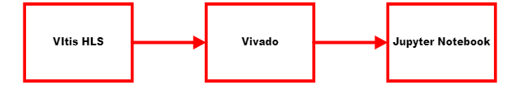
Introduce
Acceleration Flow
Synthesize a C/C++ function into RTL with the Vitis HLS
Integrate IP with the Vivado Design Suite
Test with the Jupyter Notebook
Copyright © 2024, E-Elements Technology Co., LTD.
3
Notes:
<number>

Slide 4

System Setup
Software
AMD Xilinx Vitis IDE 2022.1
Lab source
https://github.com/eefae/Basic-Development-Flow
Hardware
PYNQ-ZU
https://www.e-elements.com.tw/products/fpga_system/xup_pynq/pynq-zu/
https://github.com/Xilinx/PYNQ-ZU
Copyright © 2024, E-Elements Technology Co., LTD.
4
Notes:
<number>

Slide 5
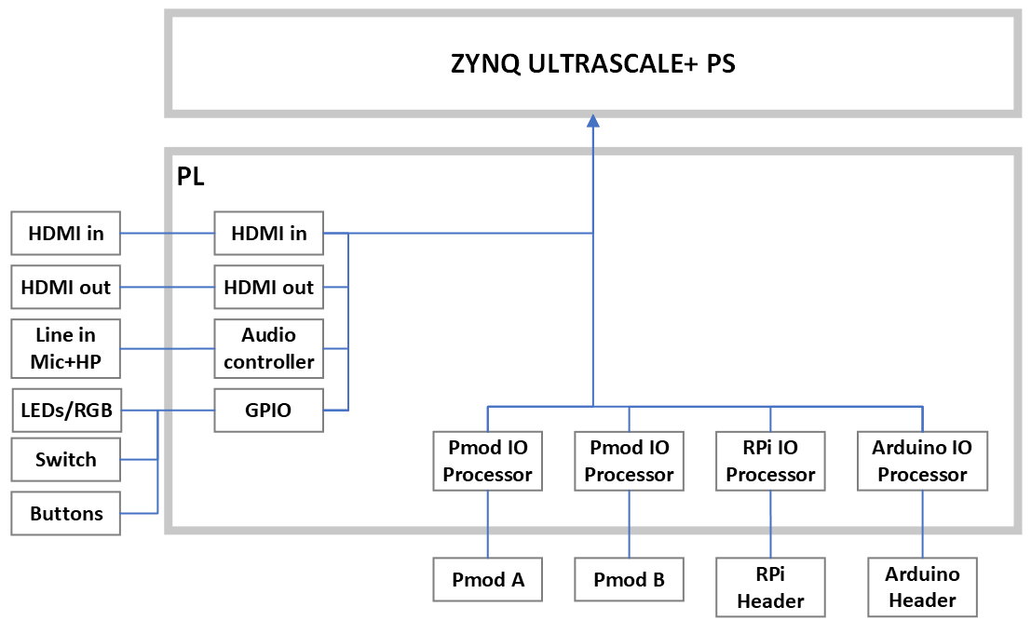
Base Overlay
Copyright © 2024, E-Elements Technology Co., LTD.
5
Notes:
<number>

Slide 6
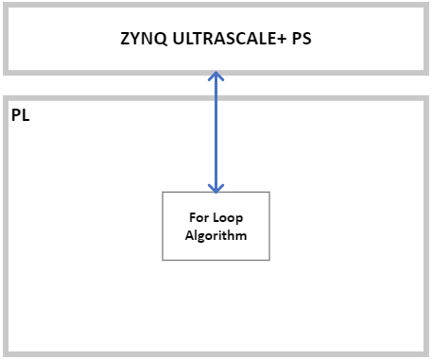
Lab1 – For Loop
Copyright © 2024, E-Elements Technology Co., LTD.
6
Notes:
<number>

Slide 7
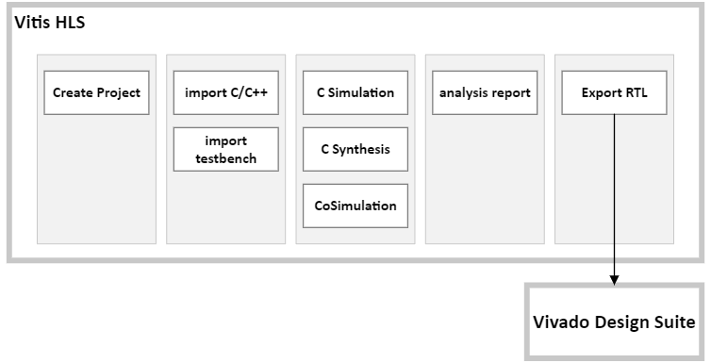
Vitis HLS
Copyright © 2024, E-Elements Technology Co., LTD.
7
Notes:
<number>

Slide 8
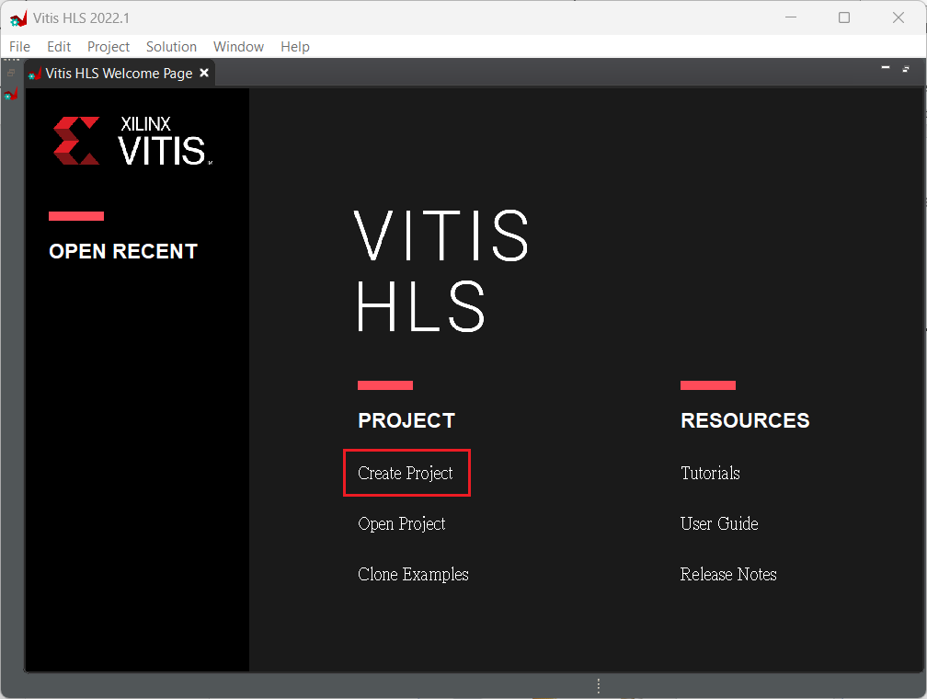
Create Project
Copyright © 2024, E-Elements Technology Co., LTD.
8
Notes:
<number>

Slide 9
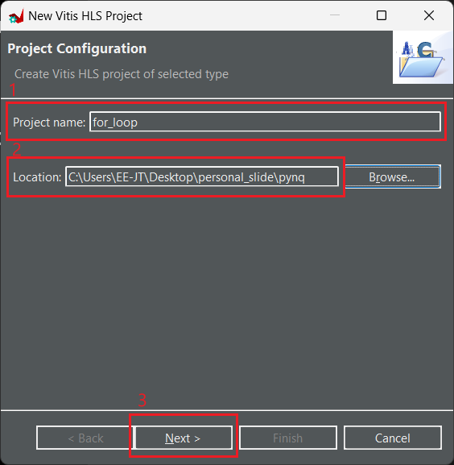
Create Project
Copyright © 2024, E-Elements Technology Co., LTD.
9
Notes:
<number>

Slide 10
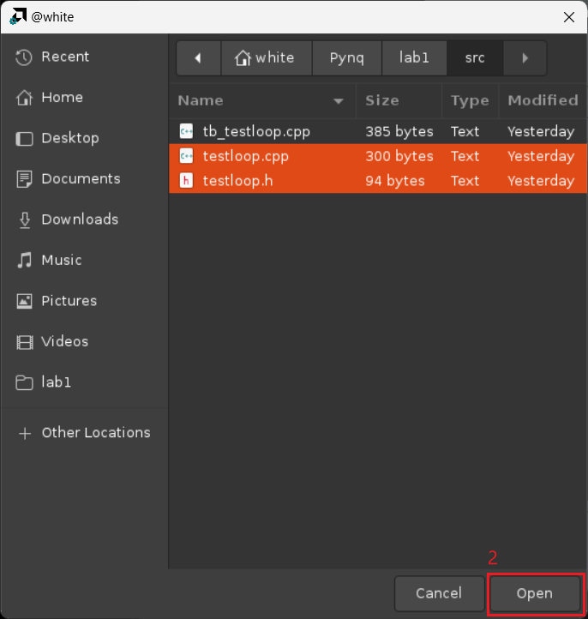
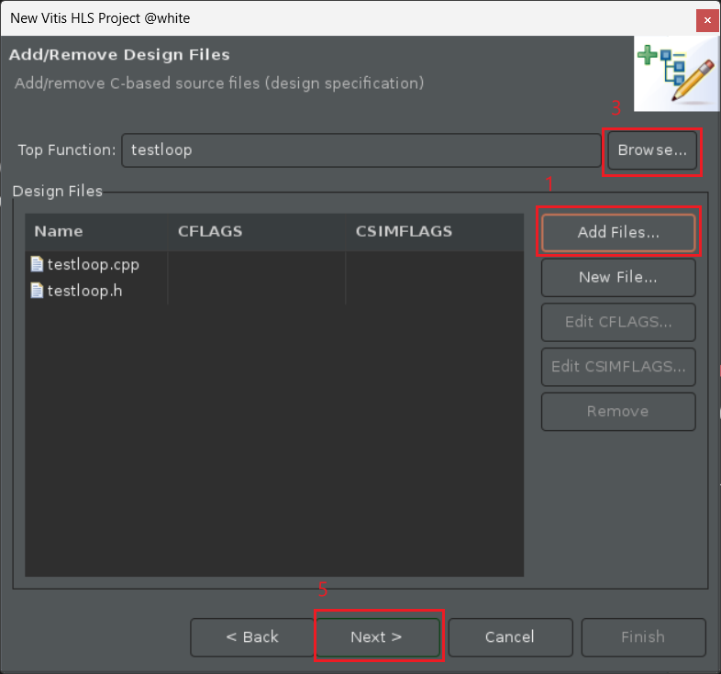
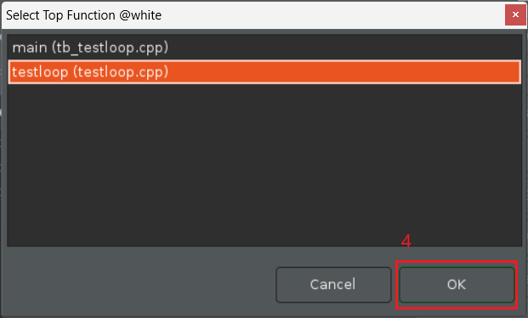
Import Source code
Copyright © 2024, E-Elements Technology Co., LTD.
10
Notes:
<number>

Slide 11
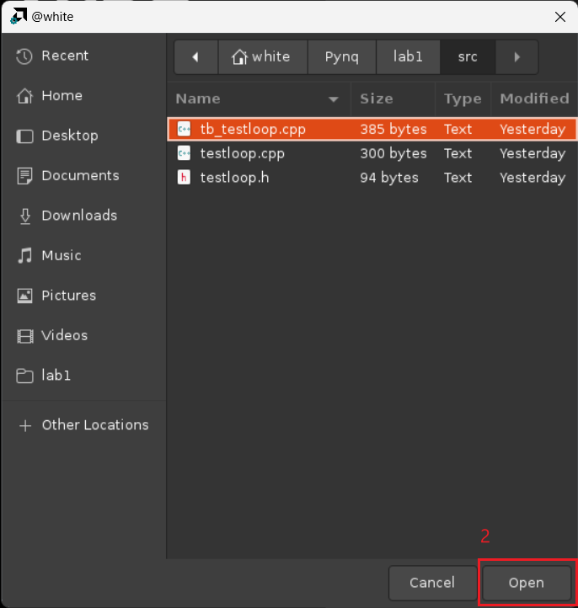
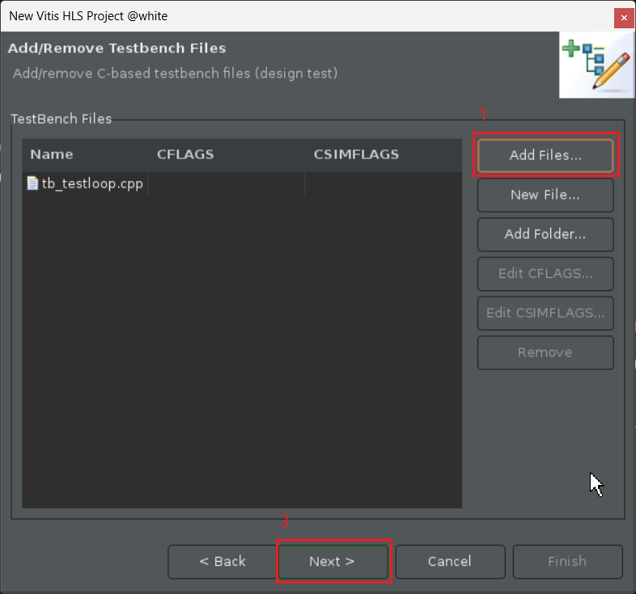
Import Source code
Copyright © 2024, E-Elements Technology Co., LTD.
11
Notes:
<number>

Slide 12
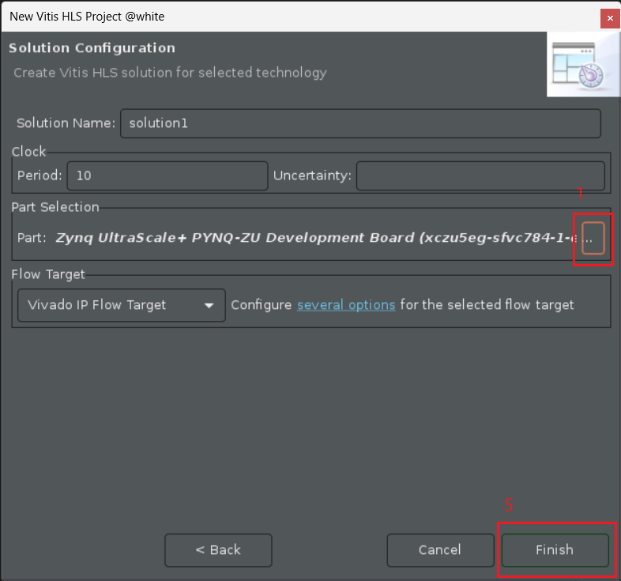
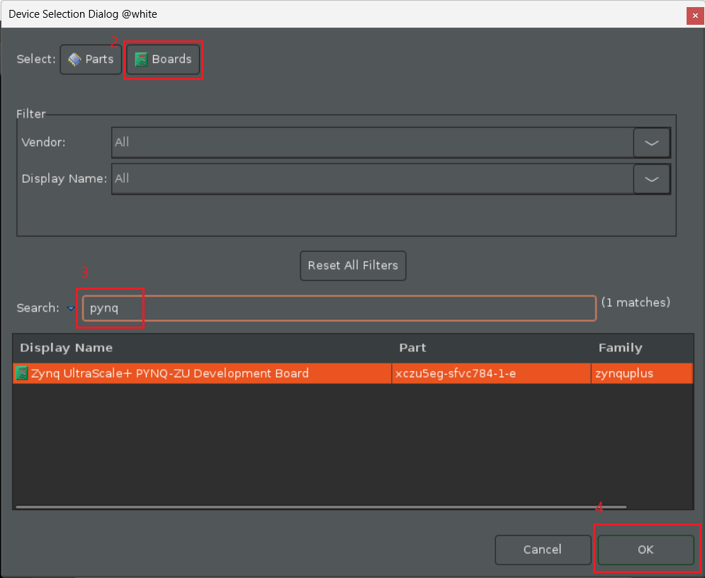
Solution Configuration
Copyright © 2024, E-Elements Technology Co., LTD.
12
Notes:
<number>

Slide 13
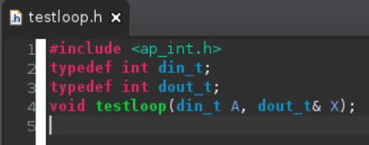
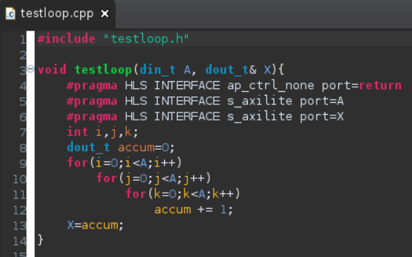
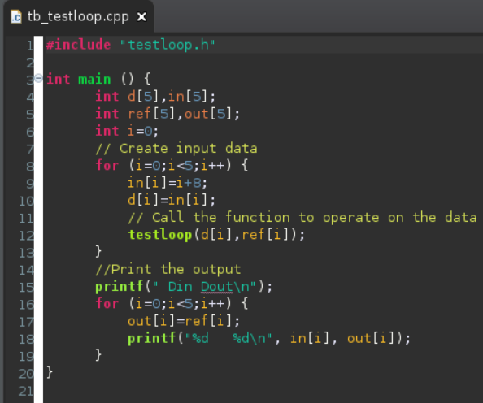
Source Code
Copyright © 2024, E-Elements Technology Co., LTD.
<number>
Notes:
<number>

Slide 14
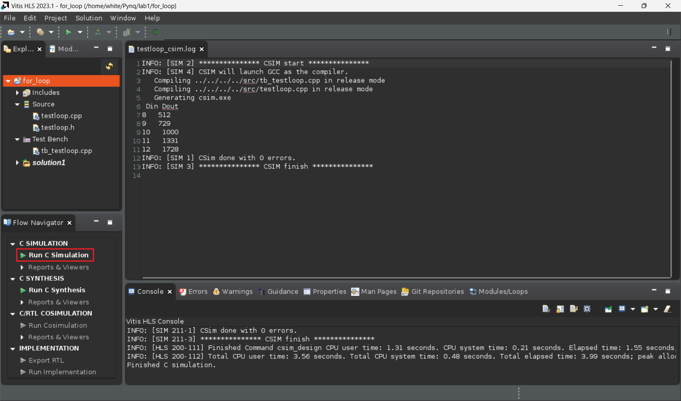
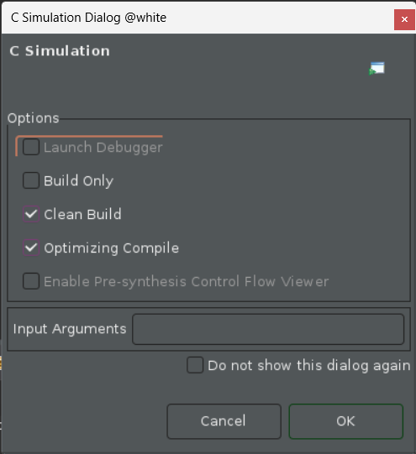
Run C Simulation
Copyright © 2024, E-Elements Technology Co., LTD.
14
Notes:
<number>

Slide 15
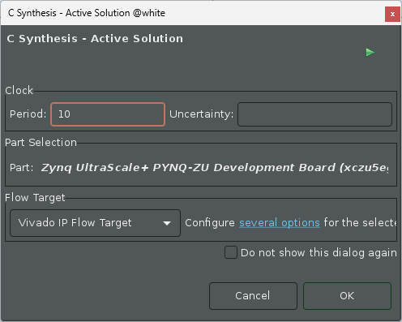
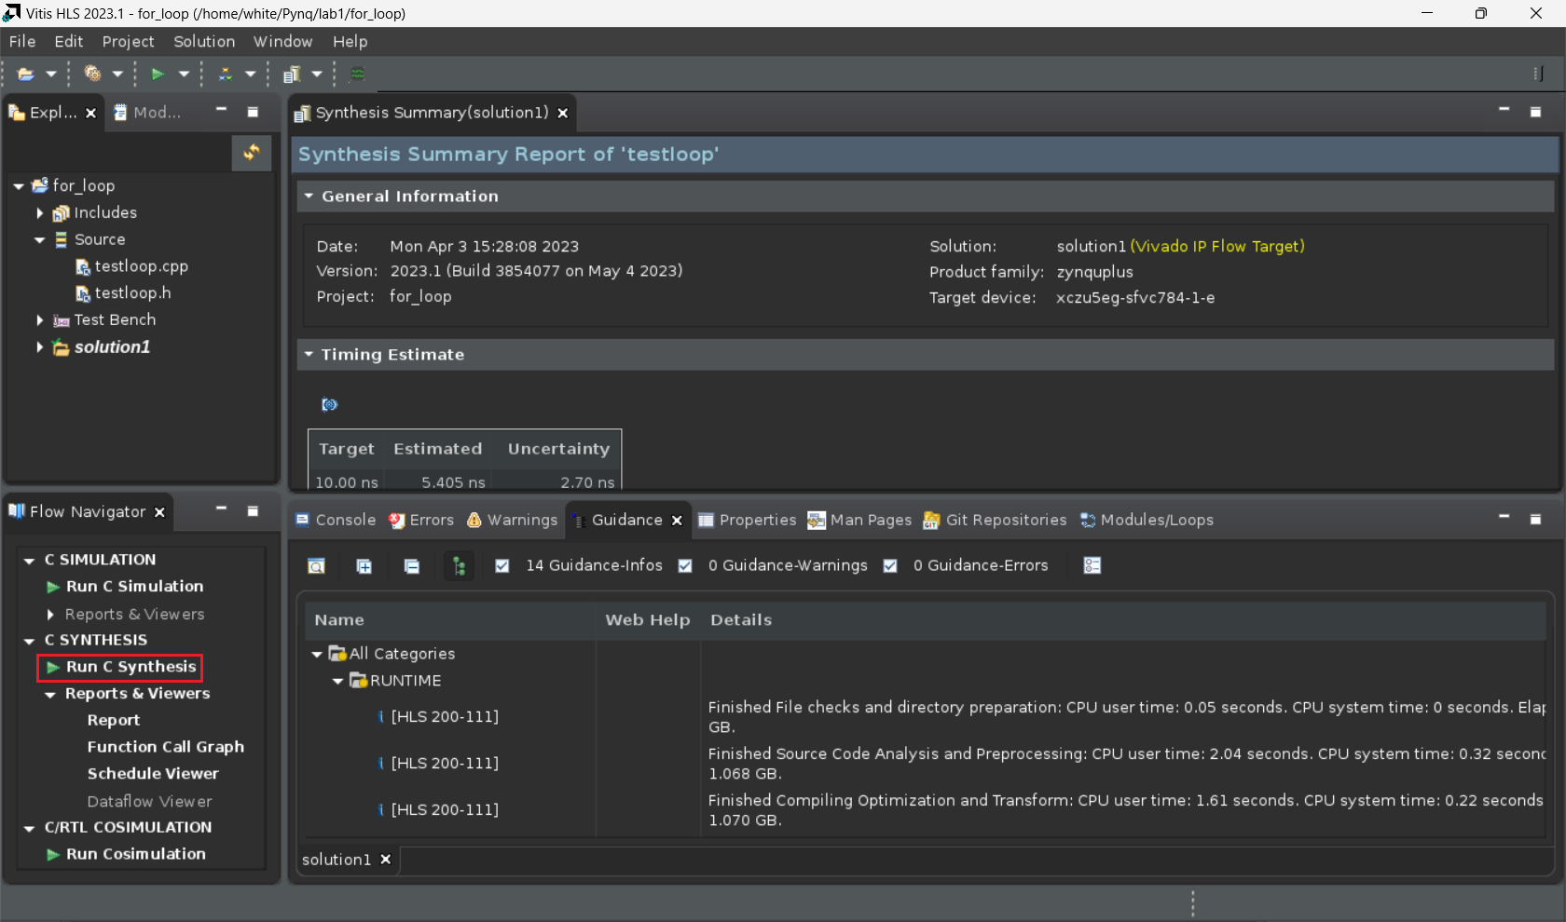
Run C Synthesis
Copyright © 2024, E-Elements Technology Co., LTD.
15
Notes:
<number>

Slide 16
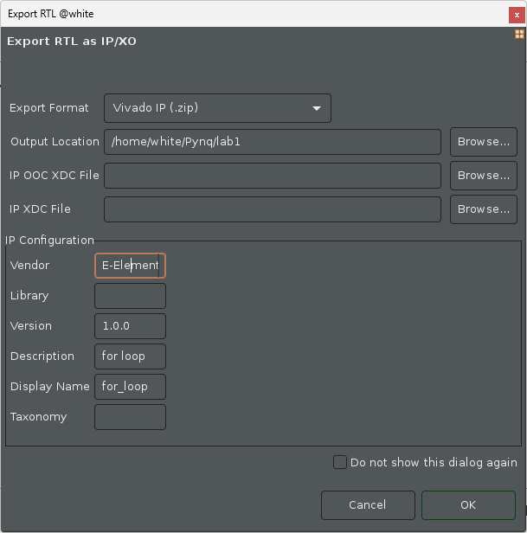
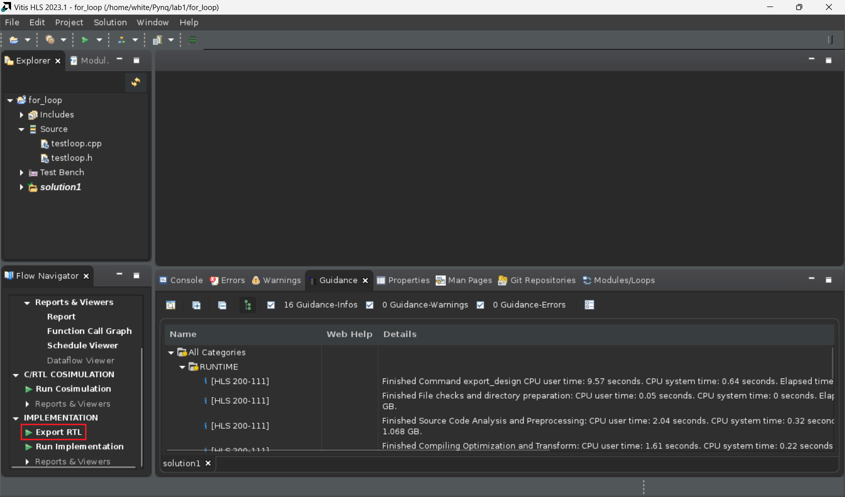
Export RTL
Copyright © 2024, E-Elements Technology Co., LTD.
16
Notes:
<number>

Slide 17
IP Information
Check memory map
the memory map file is in the
/path-to-solution1/impl/ip/drivers/testloop_v1_0/src/xtestloop_hw.h
Copyright © 2024, E-Elements Technology Co., LTD.
17
Notes:
<number>

Slide 18
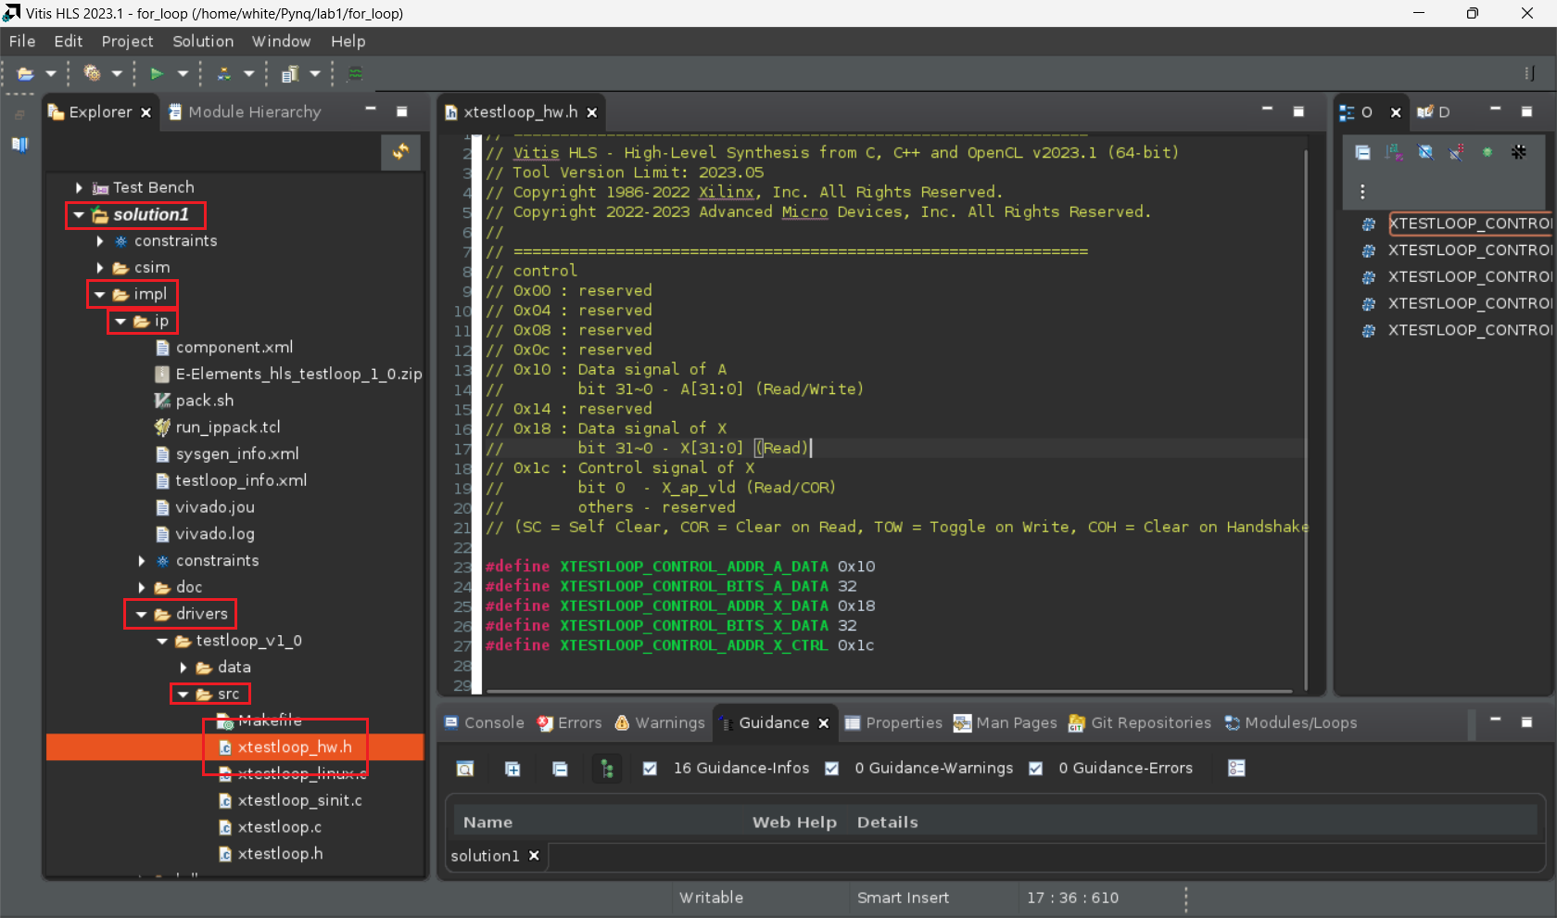
IP Information
Check memory map
the memory map file is in the
/path-to-solution1/impl/ip/drivers/testloop_v1_0/src/xtestloop_hw.h
Copyright © 2024, E-Elements Technology Co., LTD.
18
Notes:
<number>

Slide 19
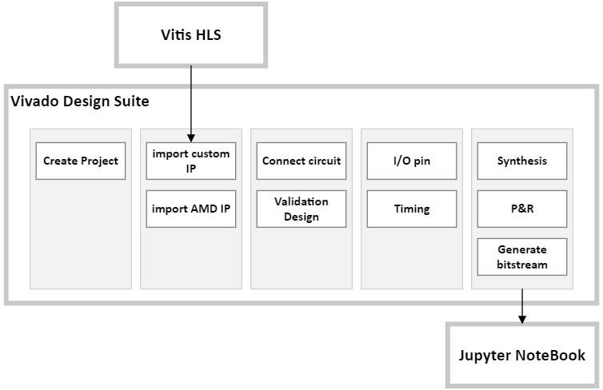
Vivado Design Suite
Copyright © 2024, E-Elements Technology Co., LTD.
19
Notes:
<number>

Slide 20
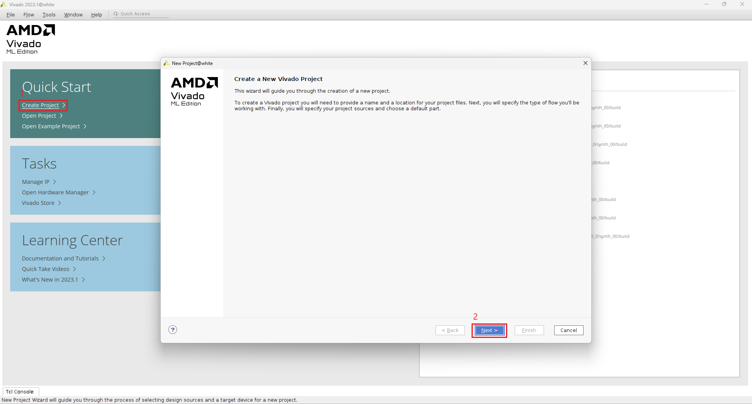
Create Project
Copyright © 2024, E-Elements Technology Co., LTD.
20
Notes:
<number>

Slide 21
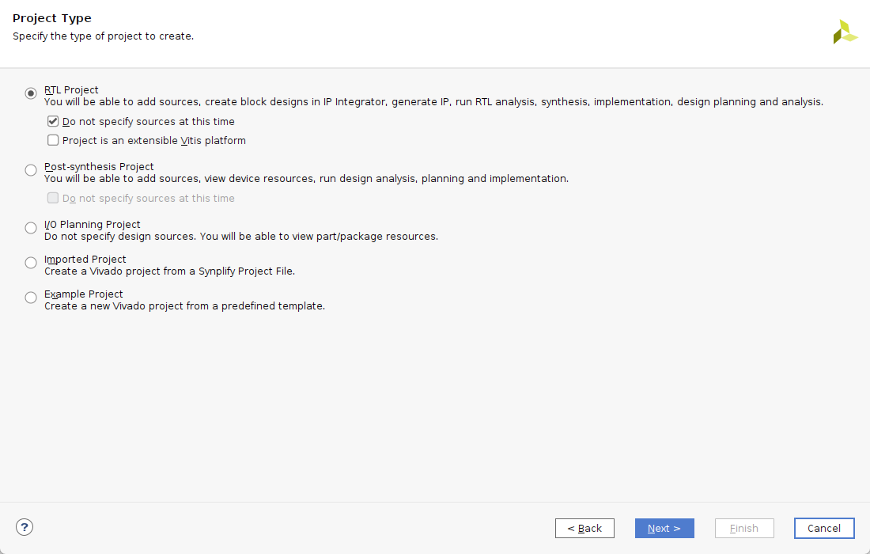
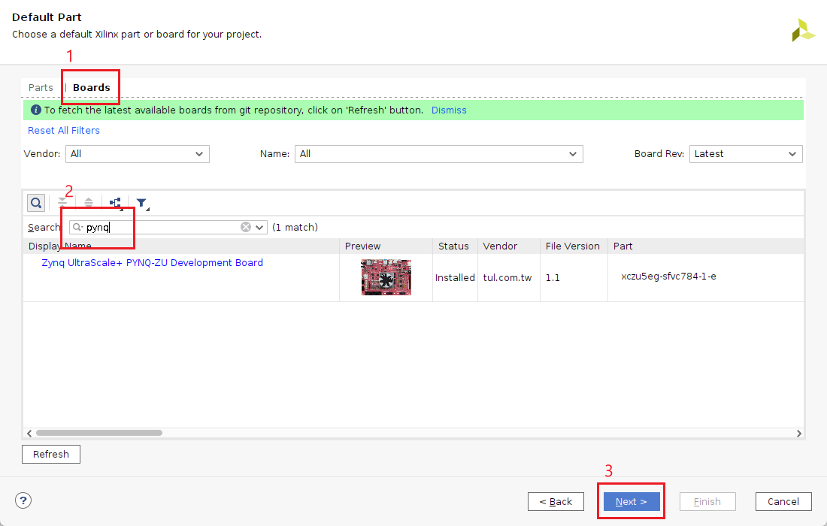
Create Project
Copyright © 2024, E-Elements Technology Co., LTD.
21
Notes:
<number>

Slide 22
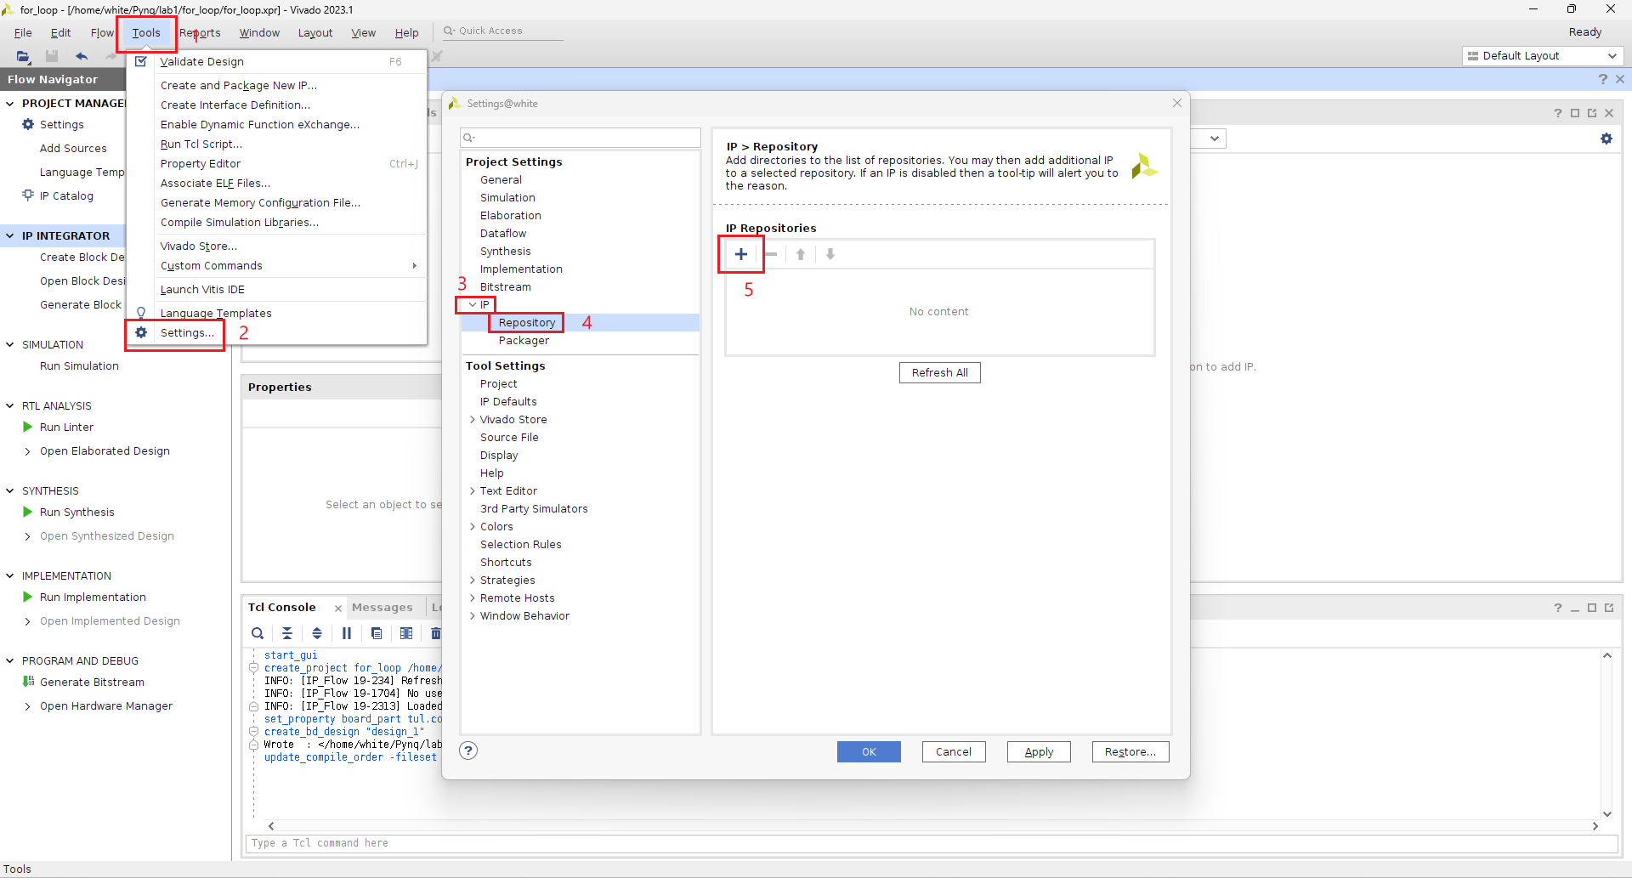
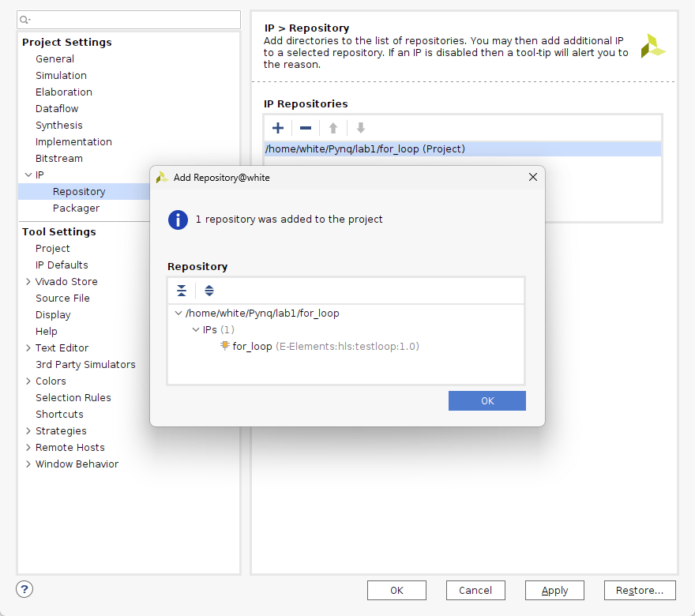
Import Custom IP
Copyright © 2024, E-Elements Technology Co., LTD.
22
Notes:
<number>

Slide 23
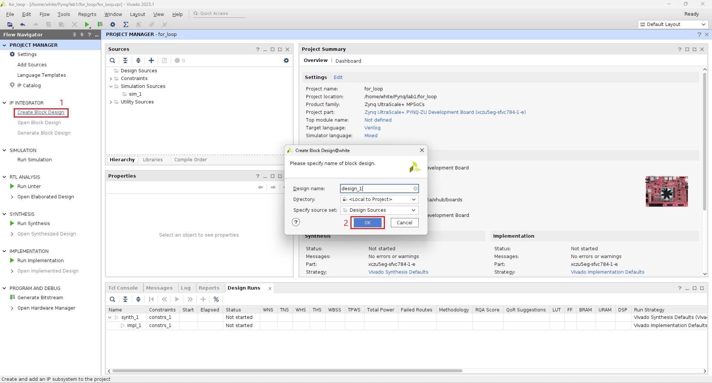
Create Block Design
Copyright © 2024, E-Elements Technology Co., LTD.
23
Notes:
<number>

Slide 24
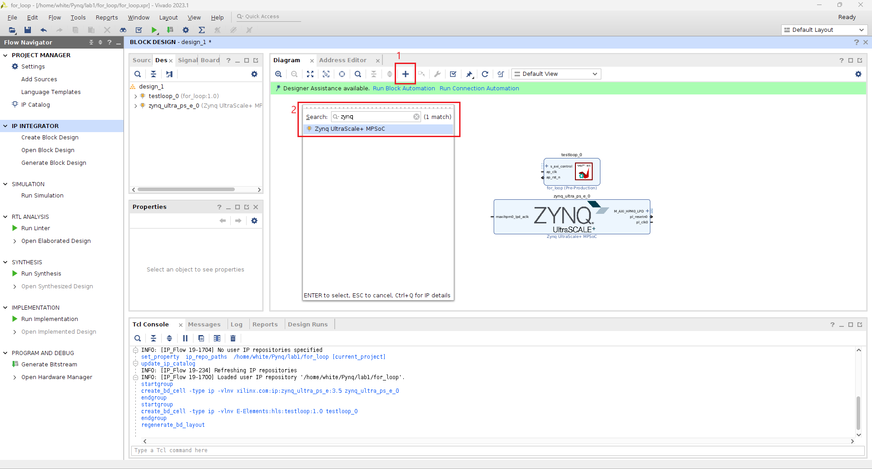
Add IP
Copyright © 2024, E-Elements Technology Co., LTD.
24
Notes:
<number>

Slide 25
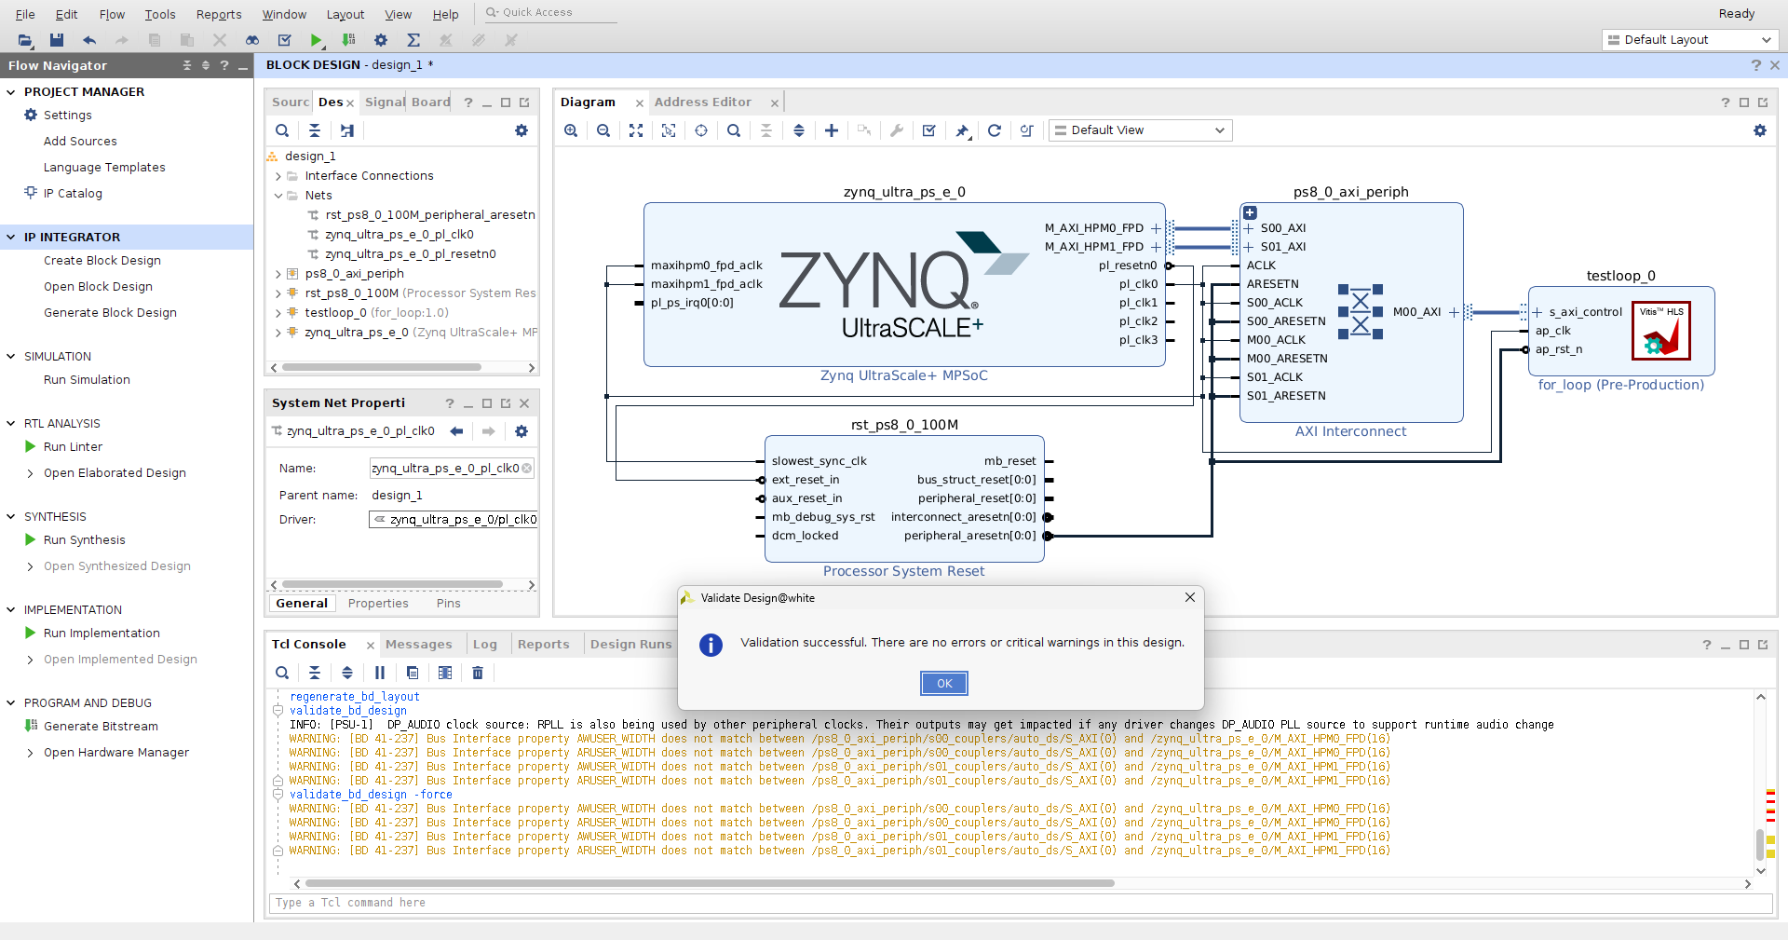
Connect/Validation IP
Copyright © 2024, E-Elements Technology Co., LTD.
25
Notes:
<number>

Slide 26
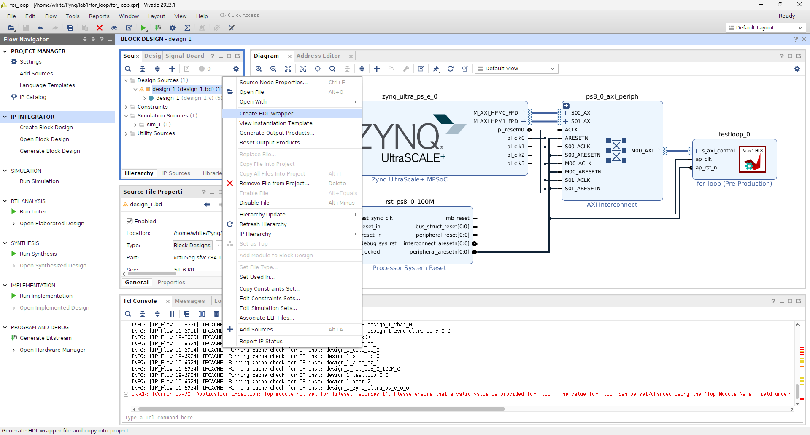
Create HDL Wrapper
Copyright © 2024, E-Elements Technology Co., LTD.
26
Notes:
<number>

Slide 27
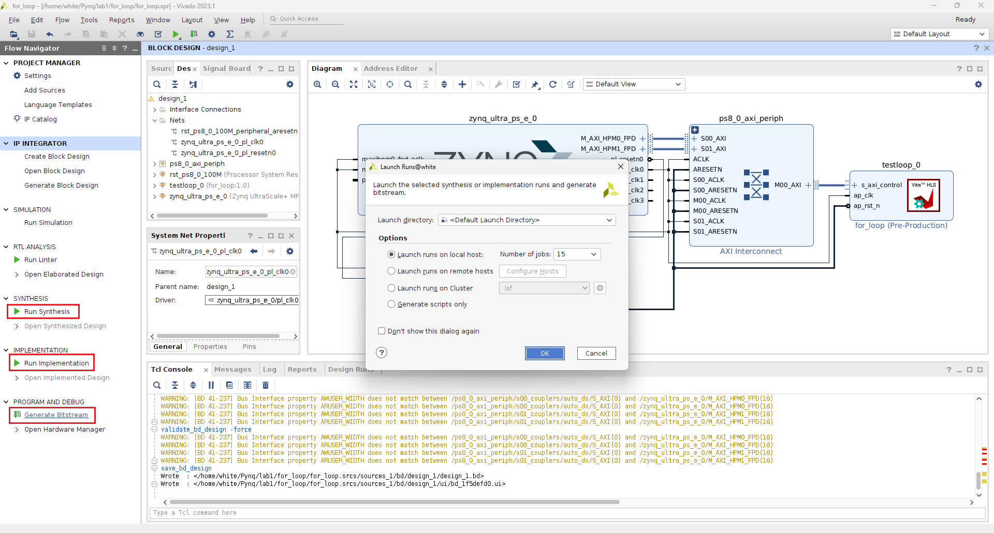
Generate Bitstream
Copyright © 2024, E-Elements Technology Co., LTD.
27
Notes:
<number>

Slide 28
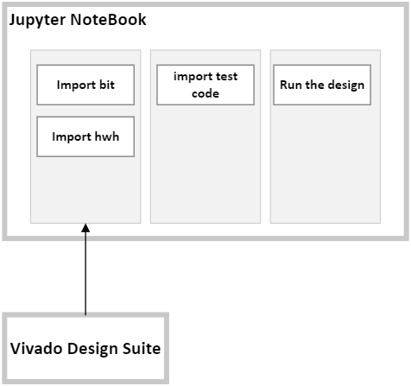
Jupyter NoteBook
Copyright © 2024, E-Elements Technology Co., LTD.
28
Notes:
<number>

Slide 29
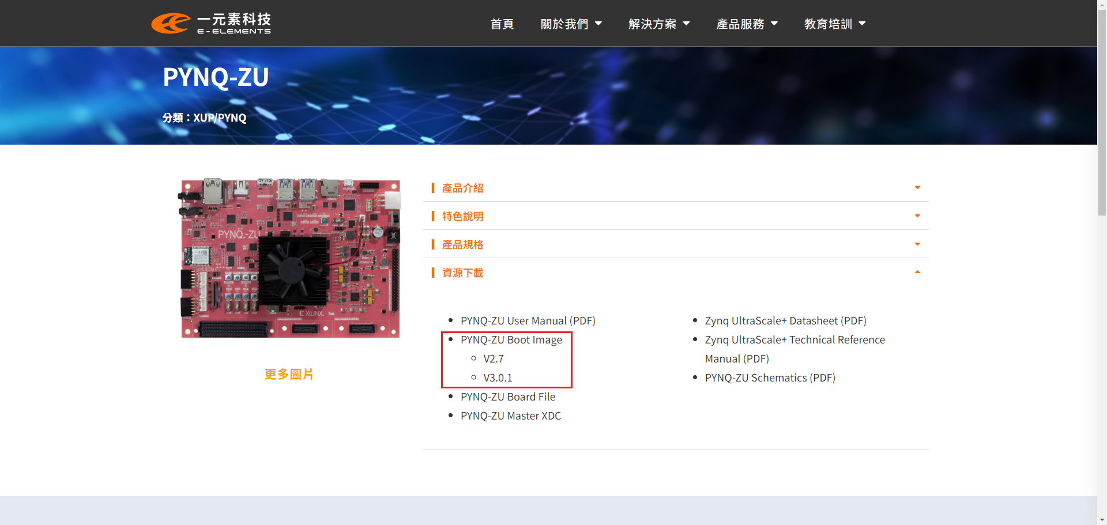
Burn the boot SD card
Copyright © 2024, E-Elements Technology Co., LTD.
29
Notes:
<number>

Slide 30
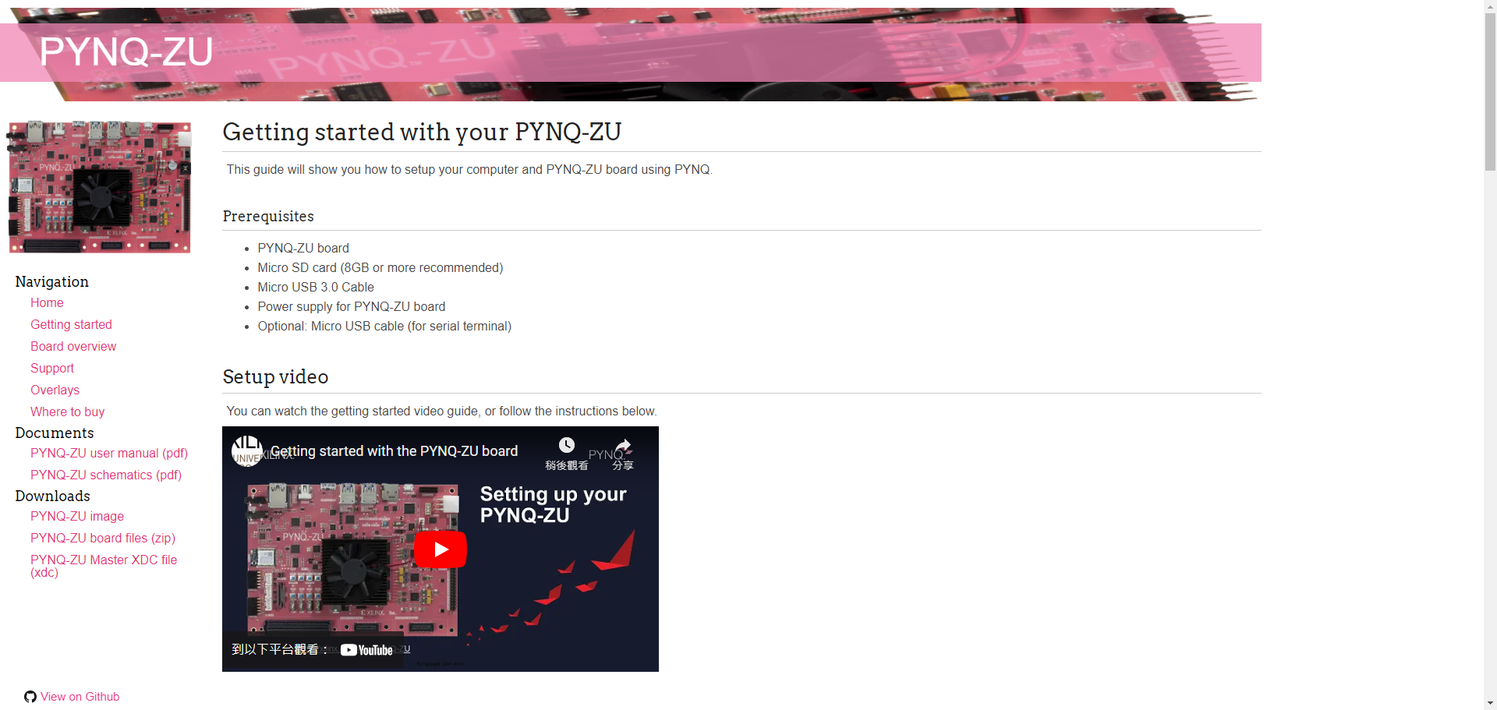
Setup Development Board
https://xilinx.github.io/PYNQ-ZU/getting_started.html
Copyright © 2024, E-Elements Technology Co., LTD.
30
Notes:
<number>

Slide 31
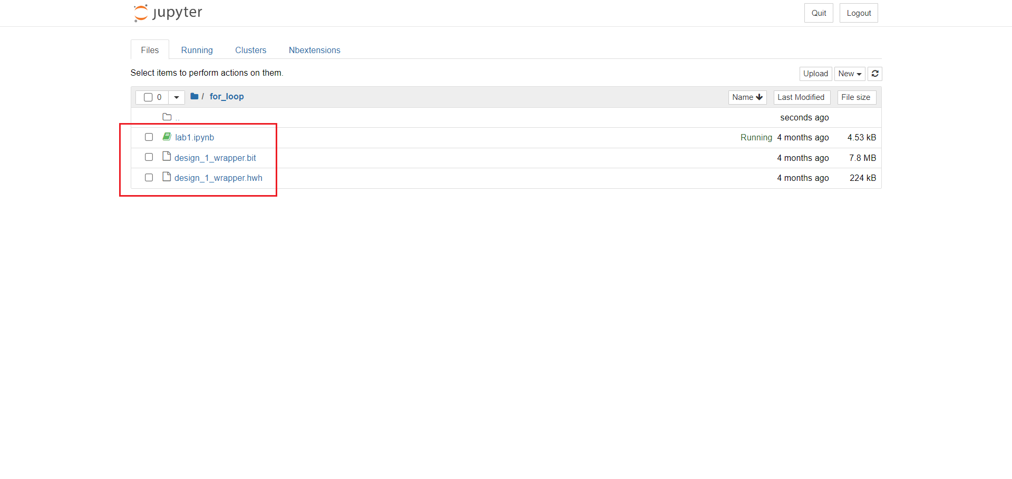
Import hwh, bit, test code
Copyright © 2024, E-Elements Technology Co., LTD.
31
Notes:
<number>

Slide 32
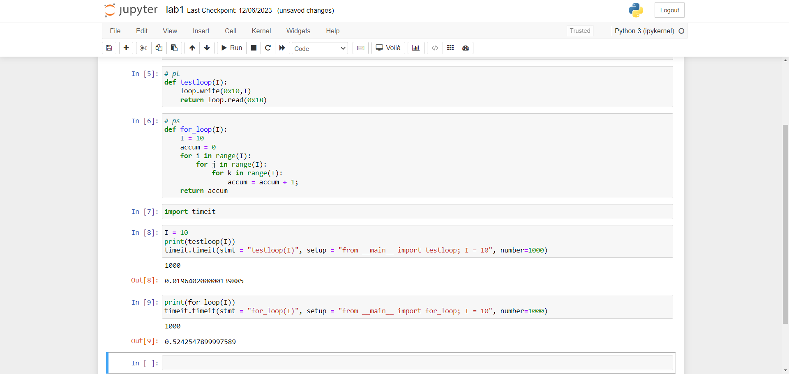
Run the design
Copyright © 2024, E-Elements Technology Co., LTD.
32
Notes:
<number>

Slide 33
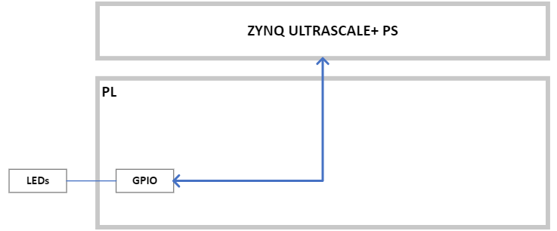
Lab2 – GPIO led control
Copyright © 2024, E-Elements Technology Co., LTD.
33
Notes:
<number>

Slide 34
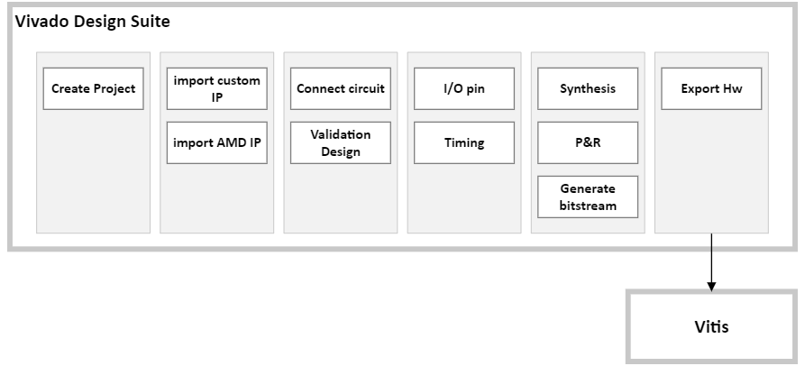
Vivado Design Suite
Copyright © 2024, E-Elements Technology Co., LTD.
34
Notes:
<number>

Slide 35
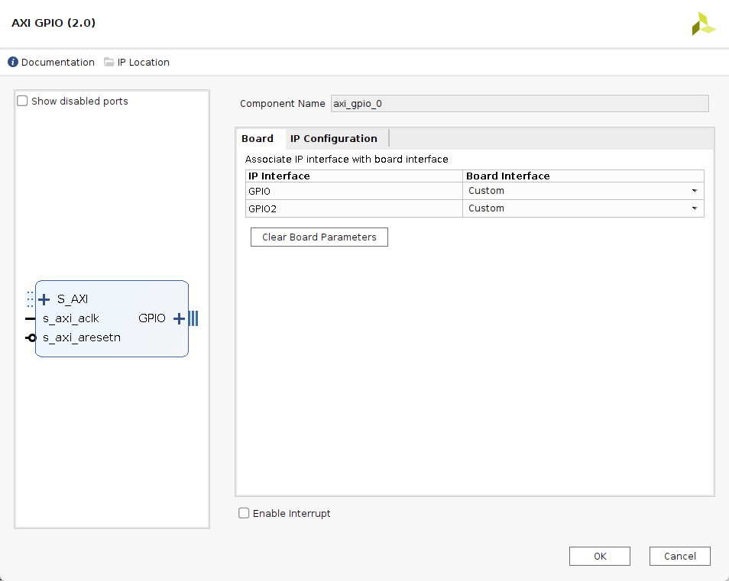
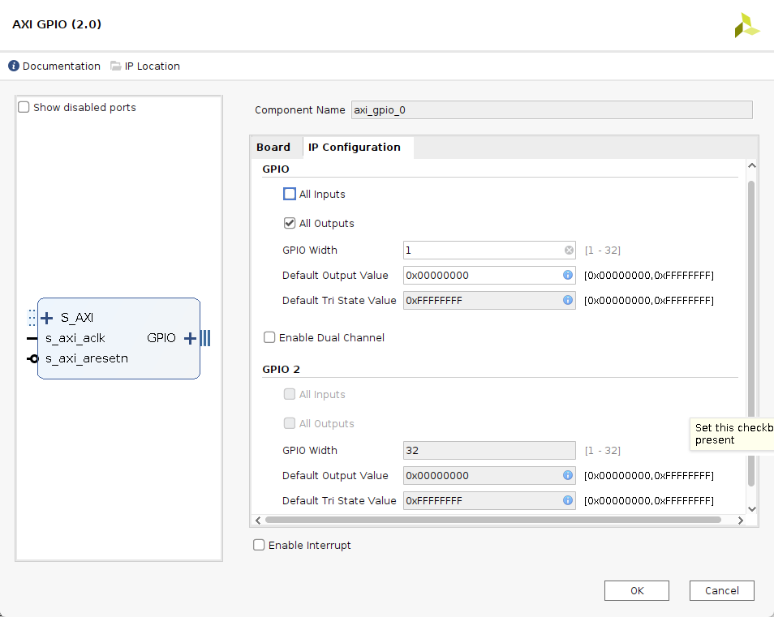
AXI GPIO (2.0)
Copyright © 2024, E-Elements Technology Co., LTD.
35
Notes:
<number>

Slide 36
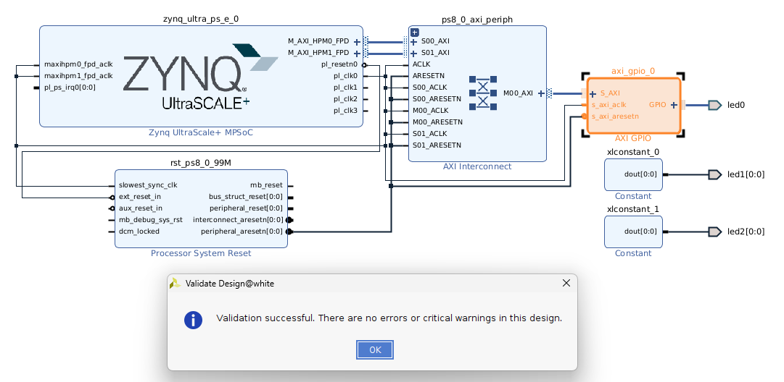
Connect/Validation IP
Copyright © 2024, E-Elements Technology Co., LTD.
36
Notes:
<number>

Slide 37
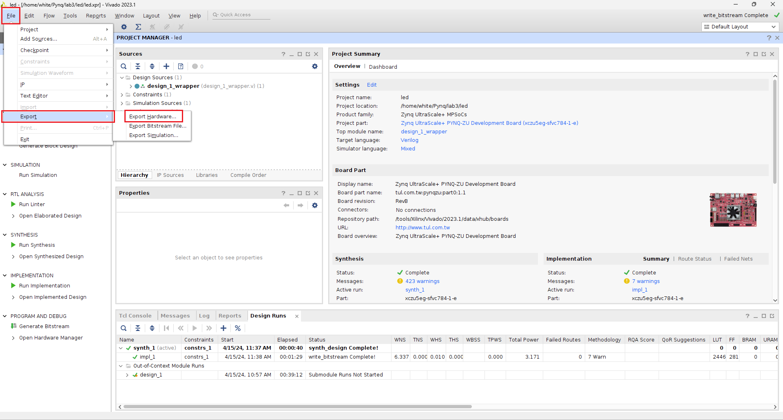
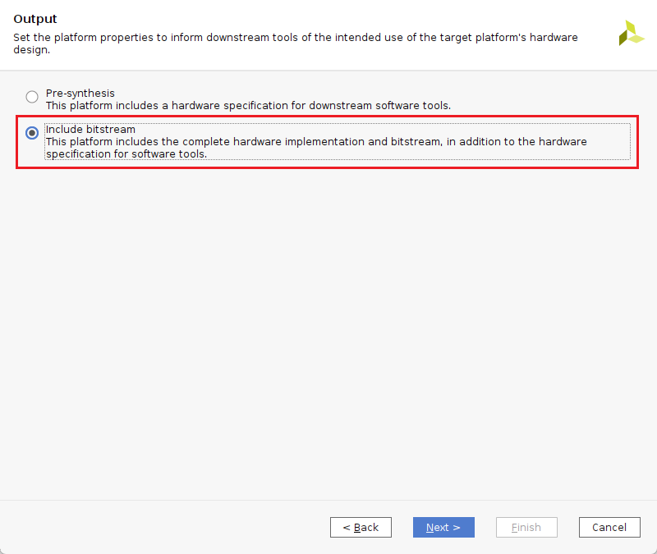
Export Hardware
Copyright © 2024, E-Elements Technology Co., LTD.
37
Notes:
<number>

Slide 38
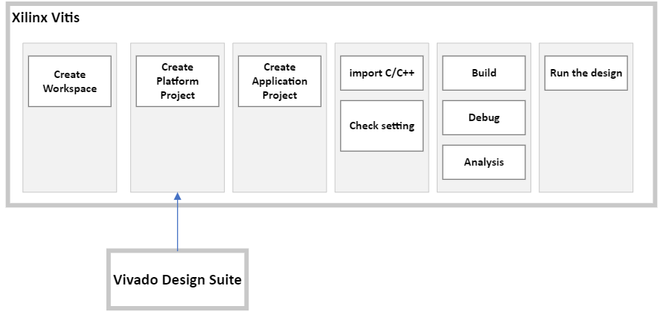
Xilinx Vitis
Copyright © 2024, E-Elements Technology Co., LTD.
38
Notes:
<number>

Slide 39
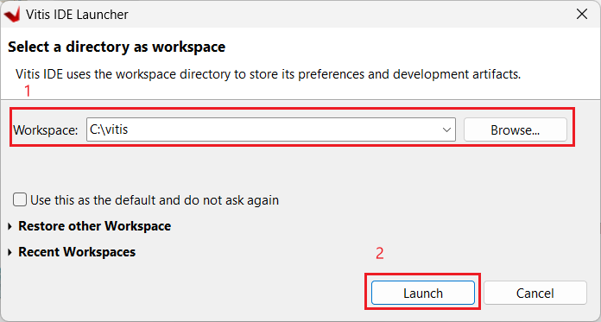
Create Workspace
Copyright © 2024, E-Elements Technology Co., LTD.
39
Notes:
<number>

Slide 40
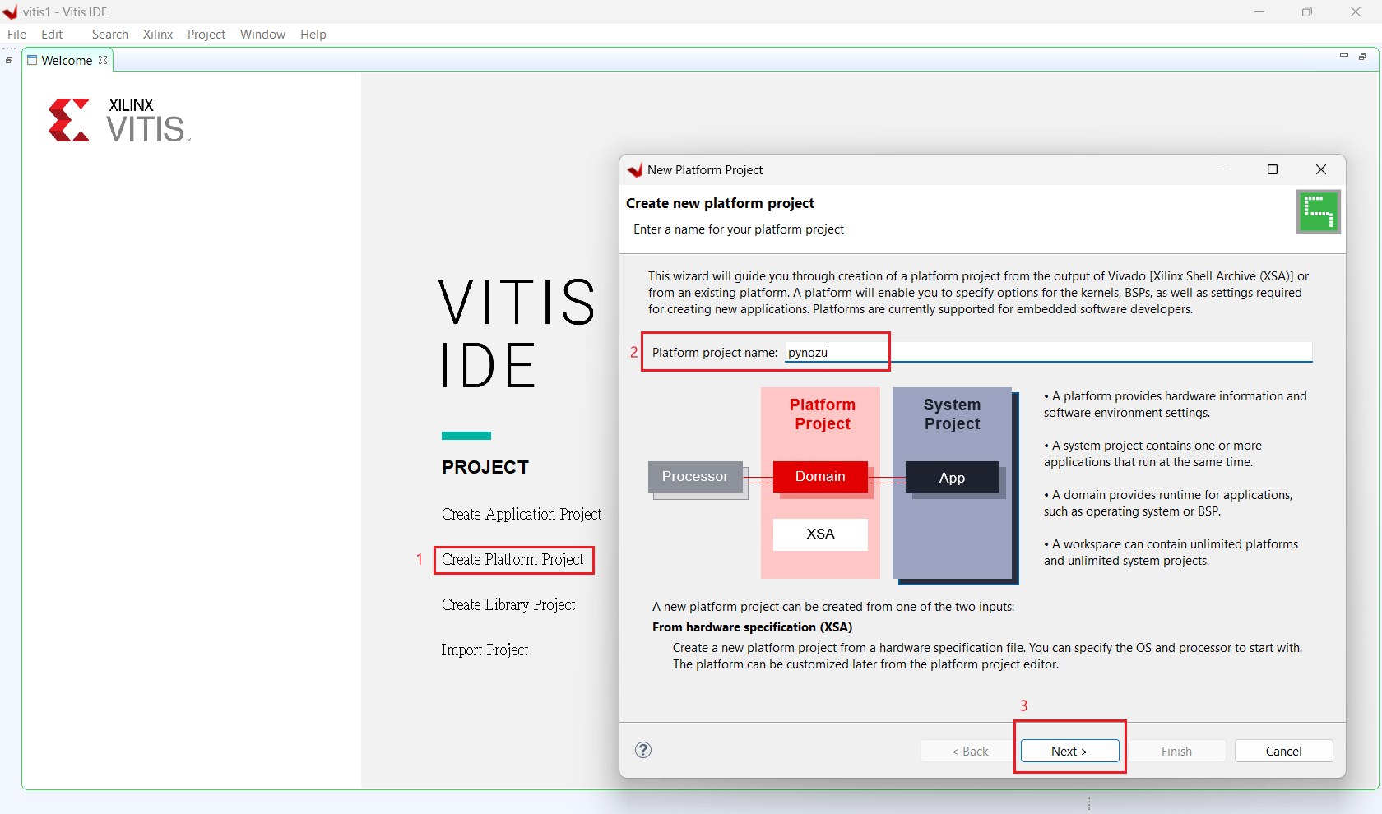
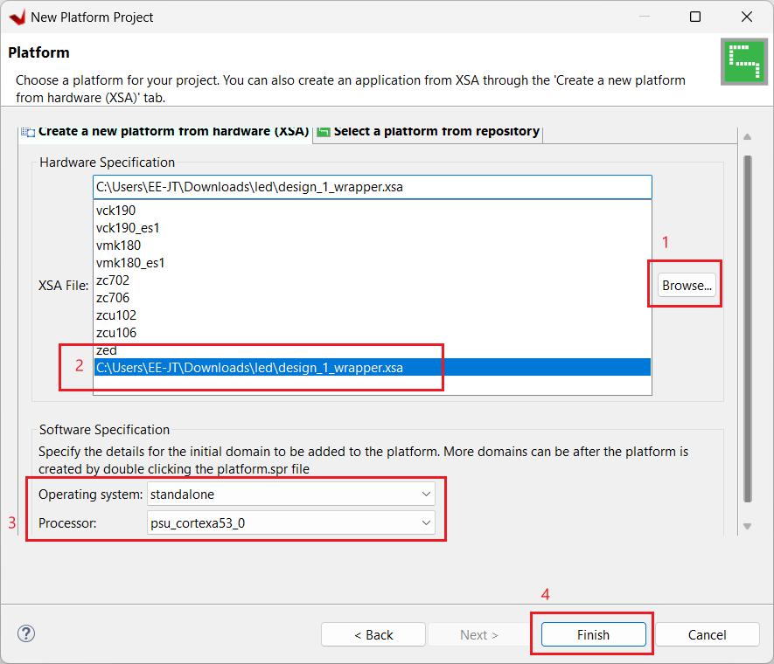
Create Platform Project
Copyright © 2024, E-Elements Technology Co., LTD.
40
Notes:
<number>

Slide 41

Create Application Project
Copyright © 2024, E-Elements Technology Co., LTD.
41
Notes:
<number>

Slide 42





Create Application Project
Copyright © 2024, E-Elements Technology Co., LTD.
42
Notes:
<number>

Slide 43

Build All Project
Copyright © 2024, E-Elements Technology Co., LTD.
43
Notes:
<number>

Slide 44

Run the Demo
Copyright © 2024, E-Elements Technology Co., LTD.
44
Notes:
<number>

Slide 45

一元素科技
sales@e-elements.com
e-elements.com
聯絡我們
Contact Us

